Slide 1
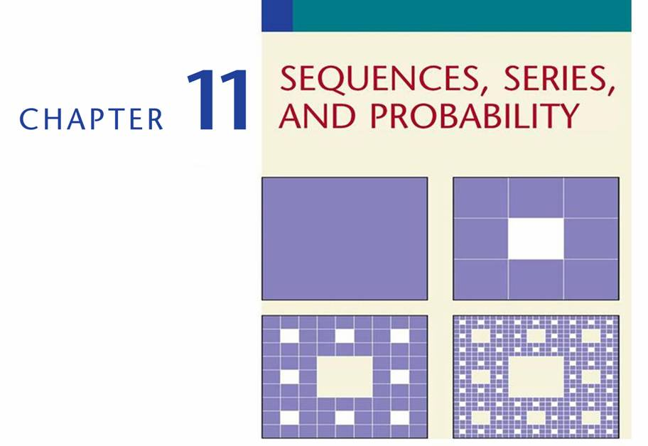
Copyright © Cengage Learning. All rights reserved.

Slide 2

SECTION 11.6
Permutations and Combinations
Copyright © Cengage Learning. All rights reserved.

Slide 3
Fundamental Counting Principle

Slide 4
Fundamental Counting Principle
Suppose that an electronics store offers a three-component stereo system for $250. A buyer must choose one amplifier, one tuner, and one pair of speakers. If the store has two models of amplifiers, three models of tuners, and two speaker models, how many different stereo systems could a consumer purchase?
This problem belongs to a class of problems called counting problems. The problem is to determine the number of ways in which the conditions of the problem can be satisfied.

Slide 5
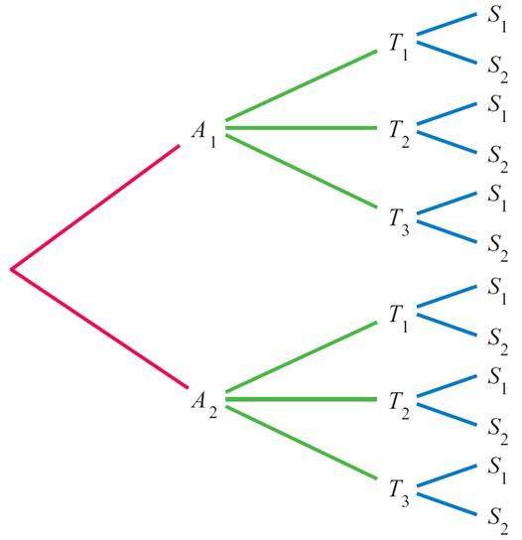
Fundamental Counting Principle
One way to do this is to make a tree diagram using
A₁ and A₂ for the amplifiers; T₁, T₂, andT₃ for the tuners;
and S₁ and S₂ for the speakers. See Figure 11.2.
Figure 11.2

Slide 6
Fundamental Counting Principle
By counting the possible systems that can be purchased, we find there are 12 different systems. Another way to arrive at this result is to find the product of the numbers of options available.
Number of number of number of number of
amplifiers tuners speakers systems
2 3 2 12
In some states, a standard car license plate consists of a nonzero digit, followed by three letters, followed by three more digits.
×
×
=
×
×
=

Slide 7
Fundamental Counting Principle
What is the maximum number of car license plates of this
type that could be issued?
If we begin a list of the possible license plates, it soon
becomes apparent that listing them all would be
time-consuming and impractical.
1AAA000, 1AAA001, 1AAA002, 1AAA003, …
Instead, the following counting principle is used. This
principle forms the basis for all counting problems.

Slide 8
Fundamental Counting Principle
Fundamental Counting Principle
Let T₁, T₂, T₃, . . . , T_{n} be a sequence of n conditions.
Suppose that T₁ can occur in m₁ ways, T₂ can occur in
m₂ ways, T₃ can occur in m₃ ways, and so on, until finally T_{n}
can occur in m_{n} ways.
Then the number of ways of satisfying the conditions
T₁, T₂, T₃, . . . , T_{n} in succession is given by the product
m₁m₂m₃ . . . m_{n}

Slide 9
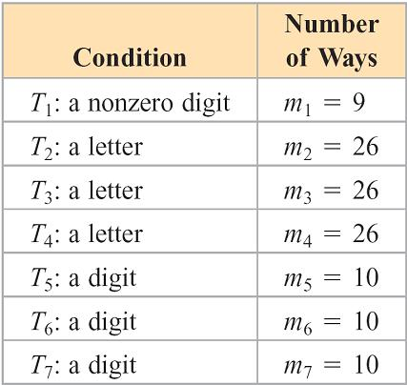
Fundamental Counting Principle
To apply the Fundamental Counting Principle to the license plate problem, first find the number of ways each condition can be satisfied, as shown in Table 11.4.
Thus we have
Number of car license plates
= 9  26  26  26  10  10  10
= 158,184,000
Table 11.4

Slide 10
Example 1 – Apply the Fundamental Counting Principle
An automobile dealer offers three midsize cars. A customer selecting one of these cars must choose one of three different engines, one of five different colors, and one of four different interior packages. How many different selections can the customer make?
Solution:
T₁: midsize car m₁ = 3 T₃: color m₃ = 5
T₂: engine m₂ = 3 T₄: interior m₄ = 4
The number of different selections is 3  3  5  4 = 180.

Slide 11
Permutations

Slide 12
Permutations
One application of the Fundamental Counting Principle is to determine the number of arrangements of distinct elements in a definite order.
Definition of a Permutation
A permutation is an arrangement of distinct objects in a definite order.
Example
abc and bca are two of the possible permutations of the
three letter a, b, and c.

Slide 13
Permutations
Consider a race with 10 runners. In how many different orders can the runners finish first, second, and third (assuming no ties)?
Any one of the 10 runners could finish first: m₁ = 10
Any one of the remaining 9 runners could be second: m₂ = 9
Any one of the remaining 8 runners could be third: m₃ = 8

Slide 14
Permutations
By the Fundamental Counting Principle, there are
10  9  8 = 720 possible first-, second-, and third-place
finishes for the 10 runners.
Using the language of permutations, we would say, “There
are 720 permutations of 10 objects (the runners) taken 3
(the number of possible finishes) at a time.”
Permutations occur so frequently in counting problems that
a formula, rather than the Fundamental Counting Principle,
is often used.

Slide 15
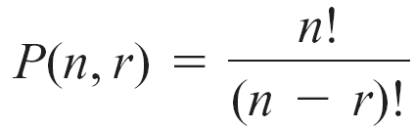
Permutations
Formula for the Number of Permutations of n Distinct
Objects Taken r at a Time
The number of permutations of n distinct objects taken r at
a time is

Slide 16
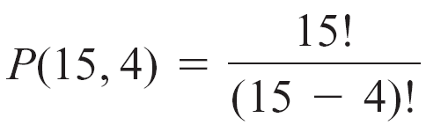
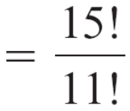
Example 2 – Find the Number of Permutations
In how many ways can a president, a vice president, a
secretary, and a treasurer be selected from a committee of
15 people?
Solution:
There are 15 distinct people to place in four positions.
Thus n = 15 and r = 4.

Slide 17
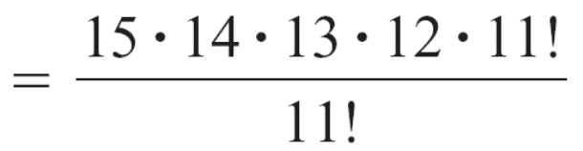
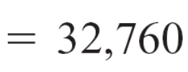
Example 2 – Solution
cont’d
There are 32,760 ways to select the officers.

Slide 18
Combinations

Slide 19
Combinations
Up to this point, we have been counting the number of distinct arrangements of objects. In some cases, we may be interested in determining the number of ways of selecting objects without regard to the order of the selection.
For example, suppose we want to select a committee
of three people from five candidates denoted by A, B, C,
D, and E. One possible committee is A, C, D.
If we select D, C, A, we still have the same committee because the order of the selection is not important.

Slide 20
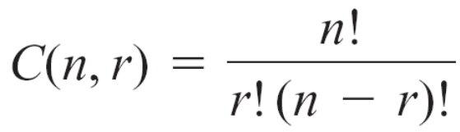
Combinations
An arrangement of objects in which the order of the
selection is not important is a combination.
Formula for the Number of Combinations of n Objects
Taken r at a Time
The number of combinations of n objects taken r at a time
is

Slide 21
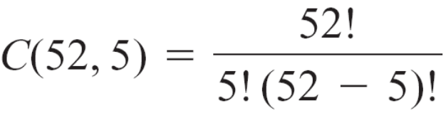
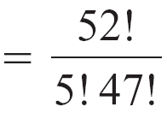
Example 4 – Find the Number of Combinations
A standard deck of playing cards consists of 52 cards. How
many five-card hands can be chosen from this deck?
Solution:
We have n = 52 and r = 5.
Thus

Slide 22
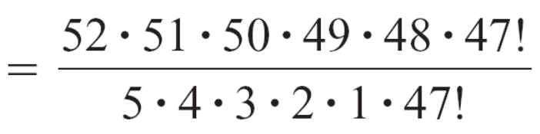

Example 4 – Solution
cont’d
There are 2,598,960 five-card hands.

Slide 23
Combinations
The difficult part of solving a counting problem is determining whether to use the counting principle, the permutation formula, or the combination formula. Following is a summary of guidelines.
Guidelines for Solving Counting Problems
1. The Fundamental Counting Principle will always work
but is not always the easiest method to apply.
2. When reading a problem, ask yourself, “Is the order of
the selection process important?” If the answer is yes,
the arrangements are permutations. If the answer is no,
the arrangements are combinations.

